Slide 1
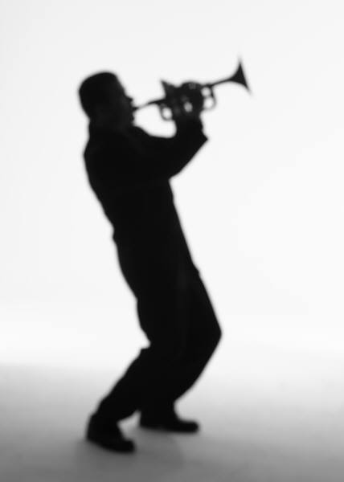
Jazz Photo Album
Cross Oceans Music

Slide 2
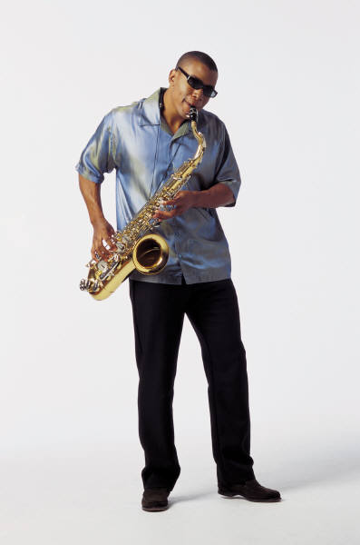
Tenor Saxophone

Slide 3
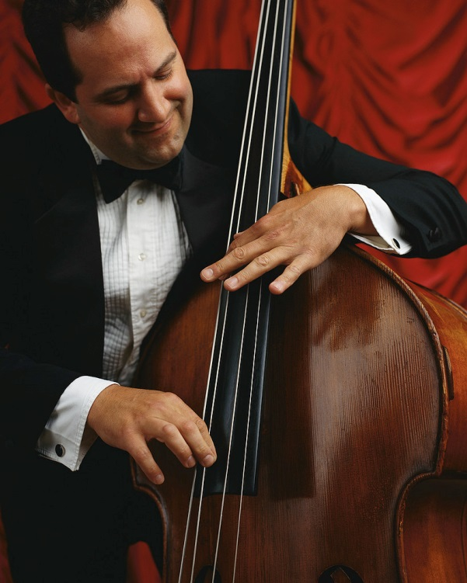
Bass

Slide 4
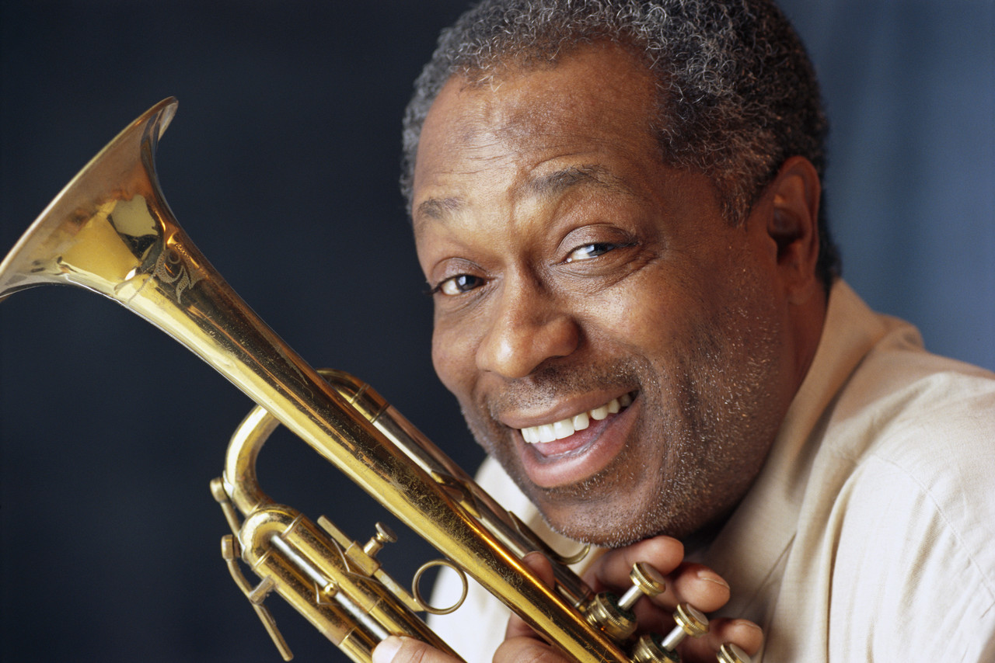
Trumpet

Slide 5
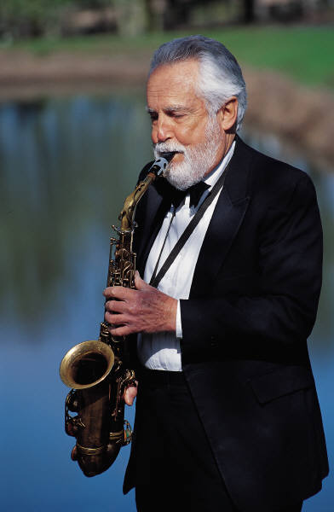
Alto Saxophone

Slide 6
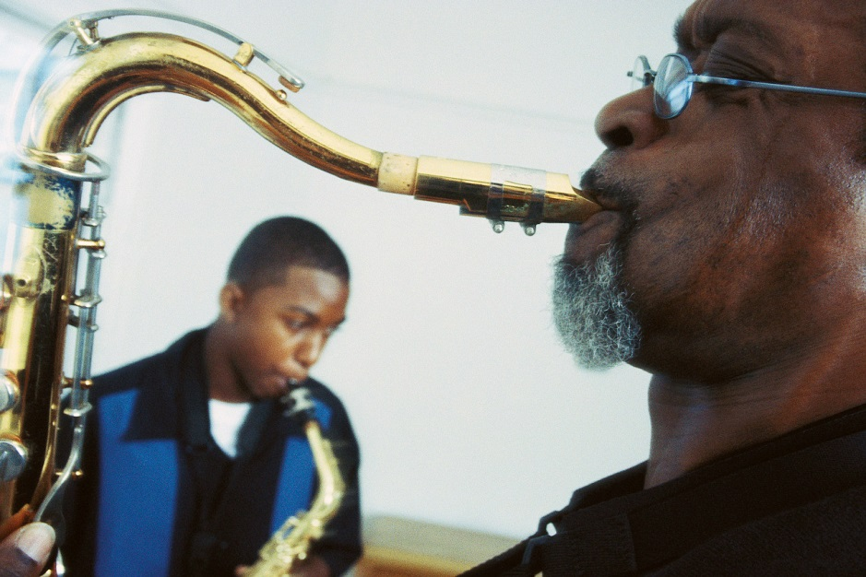
p05B_Jazz5

Slide 7
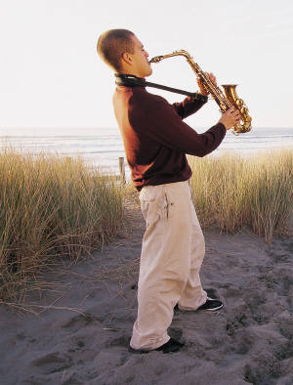
Meet our newest addition
to our jazz musicians
Alto Saxophone

